Slide 1

Actor Model
Lapusneanu Gabi
Akka.NET

Slide 2




Silent, a Short Film
Notes:
Before we start, I would like to watch an animated short movie, the winner of Oscar in 2012 created by MoonBot Studio.
It celebrates how storytellers, inventors, and technology work together to create cinema magic.

Slide 3


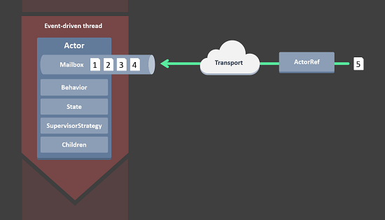

Akka.NET
Introduction
Concepts
Demo
Notes:
The presentation is divided into three parts: Introduction, Concepts and Demo.
We will go through each other in order.

Slide 4
Akka.NET
Introduction
Concepts
Demo

Slide 5

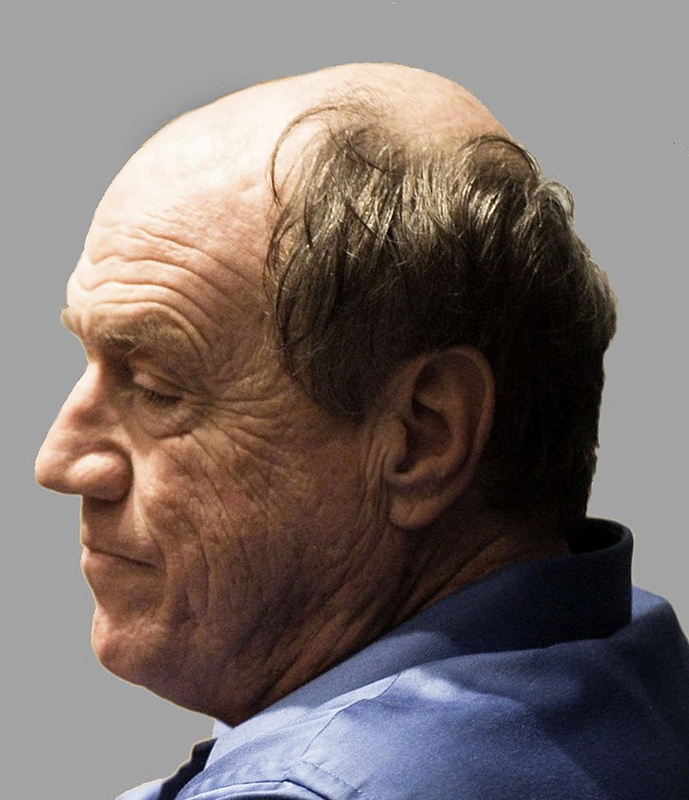
Introduction
Actor Model originated in 1973.
Actor Model is a mathematical model of concurrent computation.
Carl Hewitt
Notes:
- The first published about Actor Model was in 1973, one of its authors is Carl Hewitt.
- Actor Model is a mathematical model of concurrent computation.
- It promotes actors as the first-class unit of computation and
emphasizes communication between actors via message sending.

Slide 6


Introduction
Actor Model has mostly been associated with Erlang programming language.

Slide 7










Programming with Actors

Slide 8
Akka.NET
Introduction
Concepts
Demo

Slide 9
Akka.NET
Introduction
Concepts
Demo
Notes:
Now we can go to familiarize with the basic concepts of actor model.

Slide 10

The Actor System
The Actor System is our root on actors structure.
Notes:
The first one is The Actor System which is our root on actor structure.

Slide 11

The Actor System
The Actor System as a collaborating ensemble of actors is the natural unit for managing shared facilities like scheduling services, configuration, logging, etc.
Notes:
It is practically a theater room that provides the tools necessary for each actor to activate
and facilitate the interaction between them.

Slide 12

The Actor
Notes:
The Actor System works with actors.
An actor is an execution unit that runs concurrently with other actors.
In the Actor model, everything is an actor.
An “actor” is really just an analog for human participants in a system.
Actually it is a simple class which has its own State and Behaviour.

Slide 13

The Actor
Every Actor has a Parent.
Notes:
The structure of the System is a tree.

Slide 14
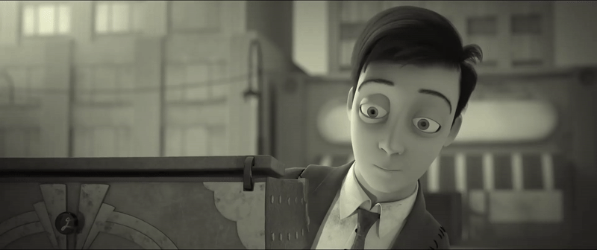
The Actor
Actors communicate with each other through messages.
Notes:
One of the main powerful features of actors is the capability to communicate with each other through messages.
Messages Are Immutable
message passing is asynchronous - the actor who sent the message can continue to do other work while the receiving actor processes the sender’s message.
All Messages Sent Are Placed In A “Mailbox” That Belongs to the Actor.
When the actor is ready to process a message, the mailbox will push the message into the actor’s OnReceive method and run the actor’s message-processing methods.
There are 3 ways to send message: Tell, Ask, Forward

Slide 15
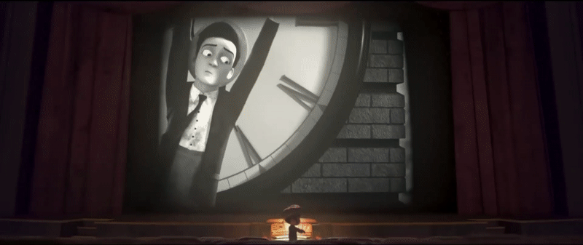
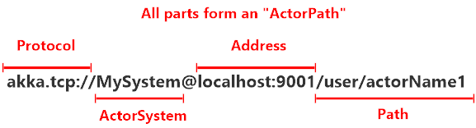
The Actor Path

Slide 16
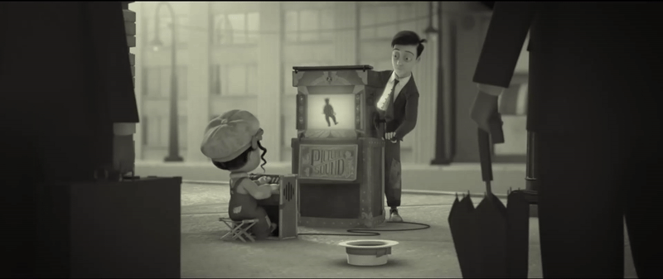
The Actor
Actors have a well defined Life-Cycle.
Notes:
Actors are created and started, and then they spend most of their lives receiving messages.
In the event that you no longer need an actor, you can terminate or “stop” an actor.
In the event that an actor accidentally crashes (i.e. throws an unhandled Exception,) the actor’s supervisor will automatically restart the actor’s lifecycle from scratch - without losing any of the remaining messages still in the actor’s mailbox.
Starting -> PreStart() -> Receving() -> Stopping -> PostStop() -> \
-> PreRestart() -> Restaring -> PostRestarting

Slide 17

The Actor
An Actor has its strategy for handling faults of its children.
Notes:
Supervision describes a dependency relationship between actors: the supervisor delegates tasks to subordinates and therefore must respond to their failures.
When a subordinate detects a failure (i.e. throws an exception), it suspends itself and all its subordinates and sends a message to its supervisor, signaling failure. Depending on the nature of the work to be supervised and the nature of the failure, the supervisor has a choice of the following four options:
Resume the subordinate, keeping its accumulated internal state
Restart the subordinate, clearing out its accumulated internal state
Stop the subordinate permanently
Escalate the failure, thereby failing itself

Slide 18
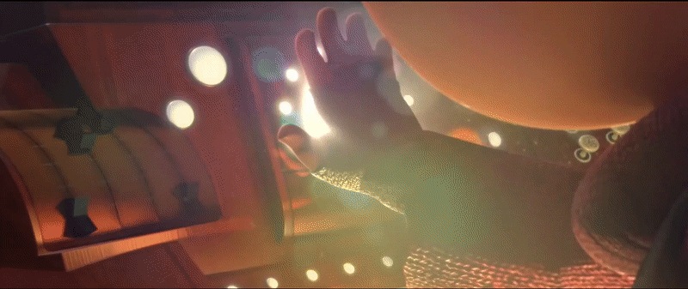
The Actor
An Actor can be remotely deployed.
Notes:
All these features are not enough for modern requirements.

Slide 19

The Actor
An Actor is reactive.

Slide 20
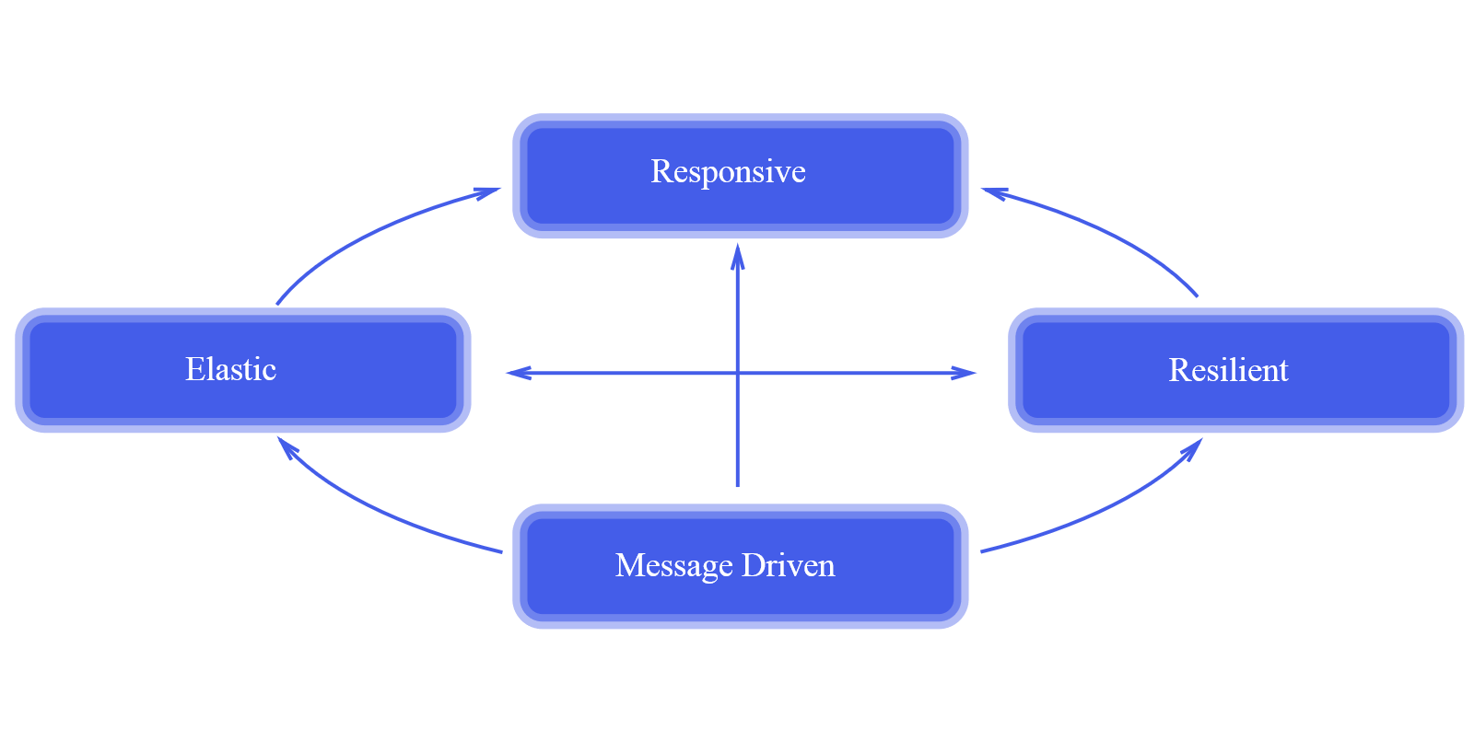
The Reactive Manifesto
https://www.reactivemanifesto.org/

Slide 21



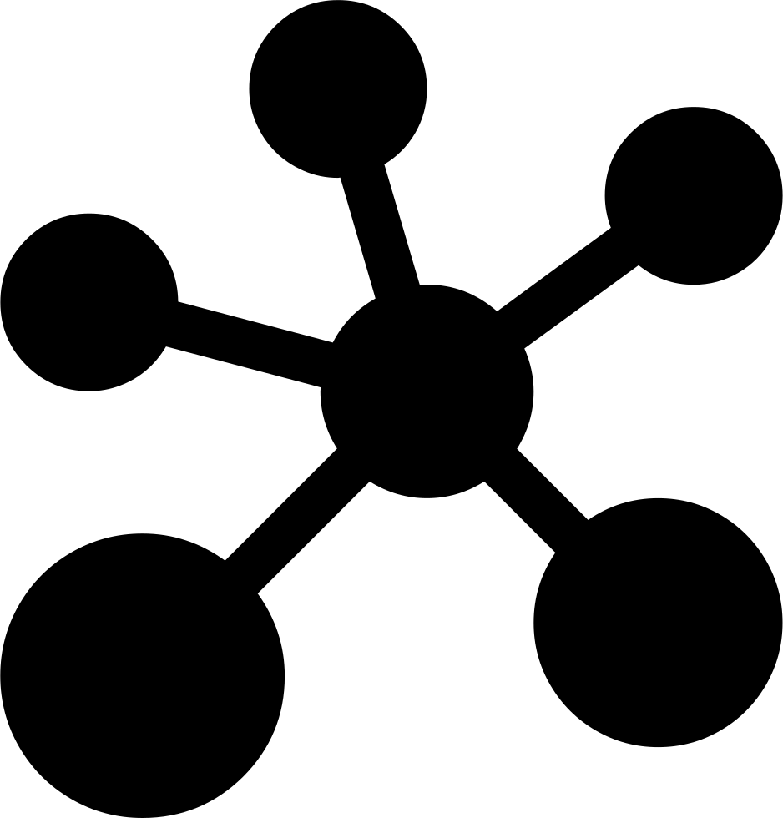

Modules
Cluster
Streams
Remote
Persistence

Slide 22
Akka.NET
Introduction
Concepts
Demo

Slide 23
Akka.NET
Introduction
Concepts
Demo

Slide 24


The End

